Slide 1
Usage OPERATIONAL PLAYBOOK

Slide 2
PROCESS FLOW
Agenda
Purpose of this Document
Definition of Responsibilities
Impacted Systems
Data Flow Diagram
Phases
Checklist
Internal Contacts
External Contacts
Reference Data

Slide 3
Purpose of This Document
The purpose of this document is to describe the Usage process flow, including a high level description of the data flow, potential points of failure, automated monitoring and alerts, and mitigation and fail over plans.
This document will also list the system owners, support contacts, and the impacted business areas and contacts.
This document will provide a clear understanding of the impact to business processing and the level of urgency to resolve issues.
This document will describe the process inputs and outputs noting data hand-offs between systems or between vendors.
This document will be the updated source for internal and external contacts, including on and off hour support contacts, escalation points and expected response times.

Slide 4
PROCESS FLOW
Definition Of Responsibilities
(Best Practices and Expectations)
Role | Team | Responsibilities | Best Practices
Process Owner | IS Billing Ops | First point of contact for process issues Initial triage of issues to identify area of failure | Join Incident Bridges and use the Playbook as a guide in issue resolution Maintain documentation (Operation Guide and Playbook) Involvement in projects impacting the process
Business Owner | PDC Provisioning and data collection | It is this team that provides the usage files that we process. | They are the first step in TOPS usage processing.
Business Owner | Inter-carrier services | This team holds the business relationship between us and our roaming partners | Questions pertaining to our roaming partners
Business Owner | Amdocs | They own the TOPS usage processing stack | Issues involving the usage flow from file to the database
Business Owner | Revenue Accounting | APRM roaming charge reconciliation | Cash differences between APRM and the Clearinghouse
Business Owner | Revenue Assurance | Billing discrepancies
Business Owner | Mobile Service Operations | The team is primarily focused on end to end service triage and troubleshooting. This includes but is not limited to CDMA, 3G/4G Data, VoLTE, SMS/MMS and Business Customer Solutions. | Issues involving data feeds.

Slide 5
PROCESS FLOW
Impacted Areas/Teams
Areas/Teams | Impact
Engineering | Collects the call records and sends them to Mediation
PDC (Mediation) | Converts the raw switch records to the UFF format then sends all files to the CallDump and billable records to TOPS.
EPC/BPT | Creates the rating configuration for Turbo-Charging
IS Billing | Without Usage there can be no bills.
Revenue Accounting | Processing late or missing usage will cause the financials' to be off.
Revenue Assurance | Bill accuracy will be affected.
Inter-Carrier Service | They own the business relationship with all outside roaming vendors.

Slide 6
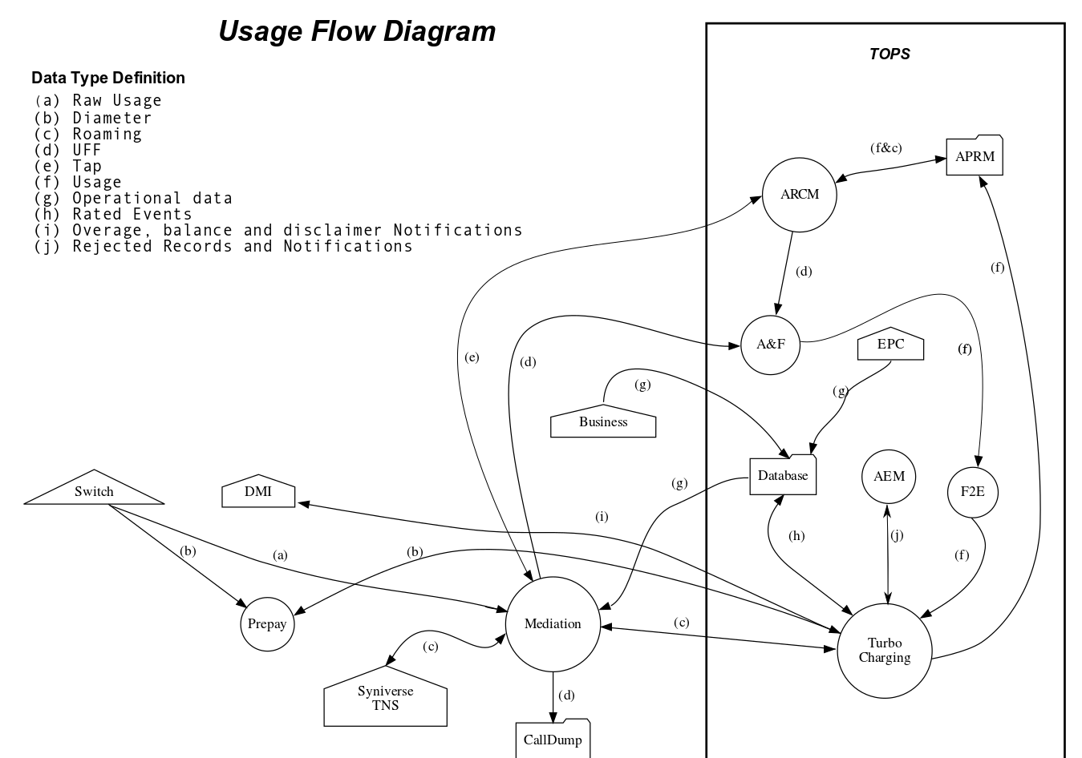
Data Flow Diagram

Slide 7
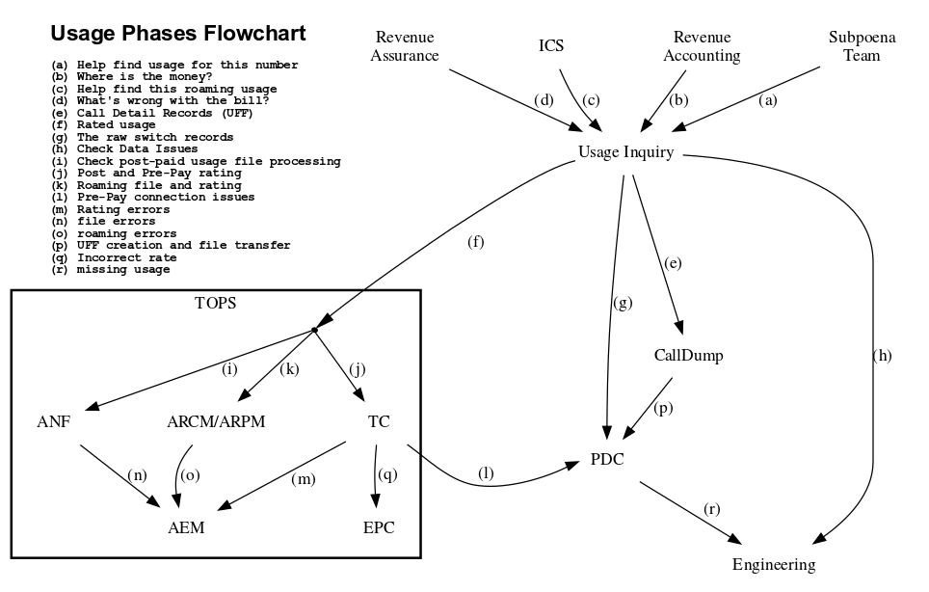
Investigation Phases

Slide 8
Checklist
Action | Owner | Considerations
Provide a clear explanation of the issue observed including any automated notifications or system response | Issue Reporter | If the information reported indicates a specific error, involve the appropriate support teams. Else follow the steps below.
Try to localize the issue | IS billing Operations | Is the error in TOPS or is it before it enters the system (Mediation). If TOPS, try to narrow it down to the most likely sub-system were the error occurred (ANF, F2E, TC, AEM, APRM,ARCM) etc.
Query the associated sub-systems database tables. | IS billing Operations / Amdocs | Each TOPS subsystem has associated tables, see the Usage Bible for more details.
Check the Logs | IS billing Operations / Amdocs | Like with tables each sub-system has a log file(s).
Check to see if the input files are delivered. | IS Billing Operations / Mediation | All files for both Post and Pre-Paid usage will be in the CallDump. Look there to see if the files have been delivered and if not contact mediation. If it is an IN/Outcollect file contact ICS.
Check to see if the event was rated correctly | EPC / IS Billing Operations | Check out the BPT tables in the usage Bible for more details.
Check the EPS Monitors | IS Billing Operations | Restart the monitors if down, see usage on call Documentation.
Verify the CallDump is working | IS Billing Operations | Restart if Necessary both the CallDump and Tomcat servers.

Slide 9
PROCESS FLOW
Alerting and Monitoring
Usage
Has the most complete and thorough monitoring system within all of TOPS.
Every usage feed and sub-system has an associated report
(See the Usage Operational Support Guide for a list of all of the monitoring reports currently active).
The EPS Monitors provides a dashboard showing all relevant TOPS usage applications.

Slide 10
Internal Contacts
PROCESS FLOW
IS Billing Operations This consists of the Operations and Dev Ops teams
Manager
Cindy Nangle - IS Billing and Revenue Dev Ops
Rathi Bommireddipalli - IS Billing and Revenue Ops
Email USCDLISOps-BillingandAROperations@uscellular.com
Remedy IS Billing and Revenue Ops IS
When to Contact Any usage related issue.
Mediation The teams purpose is to provision customers on our network as well as handling all Usage files that originate outside of TOPS
Manager Craig Stalsberg
Email USCDLISProvisioningandDataCollection@uscellular.com
Remedy NDCII-DCS - Switch Data Coll CA Switch CBB Support TOPS - AAM Provisioning
When to Contact Missing Usage (UFF, TAP, CIBER) files.
ICS (Inter-carrier Services) This team owns the business relationship between USCC and other cellular carriers that we have roaming agreements with.
Manager Liz Pierce
Email USCDLIntercarrierBusinessDepartment@uscellular.com
Remedy Intercarrier Services
When to Contact Whenever we have any question about anything for our Roaming partners. Missing a roaming file from AT&T??? Call ICS….
Revenue Accounting Looks at usage from a financial standpoint to see if all revenue is accounted for.
Manager Heather B Jeschke
Email Heather.Jeschke@uscellular.com; Miguel.Jones@uscellular.com
When to Contact They will contact us mostly about roaming usage.
Engineering This group handles all towers, switches etc. that produce usage.
Manager Rick Carlson
Email USCDLCNOMobileServicesOperations@uscellular.com
Remedy
When to Contact When there is a large decrease/increase in data usage records/volume.
Revenue Assurance Looks at random bills to find issues that may have occurred while processing usage.
Manager Sangeeta Khedekar
Email Sangeeta.Khedekar@uscellular.com; Christine.Bekos@uscellular.com; Deanna.Andrews@uscellular.com
Remedy Business Operations Support
When to Contact They will contact us if they see any discrepancy on the bill.

Slide 11
PROCESS FLOW
External Contacts
TNS The roaming clearinghouse for TAP (data, VoLTE, GSM) usage. The business relationship is held by ICS, contact them for any questions.
Syniverse The roaming clearinghouse for CDMA (voice, 3G) usage, contact through ICS.
Amdocs Our business partner for all billing. The three gentlemen below are our usage experts for all things TOPS. If there is a question you can't answer these are the guys to contact.
Serhiy Potishuk
Email SERHIYP@amdocs.com
When to contact Handles most APRM/ARCM issues
Amit Dror
Email Amit.Dror@amdocs.com>
When to contact Handles most Turbo-Charging/AEM questions.
Satish Kumar Thatikonda
Email Satish.Thatikonda@amdocs.com
When to contact Everything that is usage related except Turbo-Charging or ARPM.

Slide 12
PROCESS FLOW
REFERENCE DATA
Usage Operational Support Guide
The Usage Bible

Slide 13
Revision History – Shows changes and approvals to this document
Version | Date | Description | Author
0.1 | 2/8/2020 | Initial draft for usage processing. | David Balchen
0.2 | 2/28/2020 | Draft #2 | David Balchen

